Slide 1
Notes
Key
Function OK
Function not OK
Cannot check as other functions not working
Change

Slide 2
Sequence
The Home Page should be titled “Production Lot Control And Traceability”
The page should display 3 pictures with supporting text and two buttons to register a new user or login
Page 2 should be titled “Login”
RFID box should be in focus on page load
Login should be possible by two methods, only one method will be chosen by the user
Method 1, RFID scan
Method 2, username and password
Login details must be verified in SQL table “tbl_User”
If login is incorrect, display error message
If login correct, store user “LastLoginDate”, set “Active” flag to 1 and open “Job Bag Overview” (page 4)
The “Active” flag for the current user should be reset to 0 on logout
Page 3 should be titled “Registration”
The registration page must be password protected to limit who can register new users, set password as “admin”
All mandatory fields must filled in to complete registration for a new user (only email is optional)
Page 4 should be titled “Job Bag Overview”
On page load, enable only the three dropdown boxes (“Technology”, “Machine”, “Lot”) linked to SQL tables of the same name.
All dropdown box selections are mandatory, selections must be made in left to right order.
The dropdown boxes should be cascading (i.e. limited selection)
MachineTechnology box should list all technologies
box should list only the machines linked to the selected technology (I sent an example of a jquery to do this)
Lot box should list only the lots linked to the selected machine (I sent an example of a jquery to do this)
If the lot record is already being accessed by another user, display error message and logout the user back to the “Home Page”
If the lot record is not in use, lookup the “Lot” in SQL View “qry_Lot”, and load all relevant data
All data must remain loaded until logout, even the page is temporarily exited
For security reasons, auto logout to “Home Page” after 10 minutes of no activity on this page
Show countdown in bottom right hand corner of screen to indicate remaining time before auto log out
Use menu drop downs (at top of screen) for further functionality

Slide 3
Page 5 should be titled “Line Clearance” and automatically display the currently selected LotName from the Job Bag Overview page
All records from the currently selected Lot stored in SQL table “tbl_LineClearance” should be displayed but must not be editable
The user should click in the log box to add a new record, actual date/time should be auto populated on click and the Tech RFID box should now be in focus
The Tech will scan their RFID tag, the tag number should be verified in the SQL table “tbl_User”. If the RFID tag number is not recognised, display message “RFID not recognised, please try again”, If the RFID tag number is recognised, the matching “Username” in SQL table “tbl_User” should be loaded into the adacjent text box and the QC RID box should now be in focus
The QC will scan their RFID tag, the tag number should be verified in the SQL table “tbl_User”. If the RFID tag number is not recognised, display message “RFID not recognised, please try again”, If the RFID tag number is recognised, the matching “Username” in SQL table “tbl_User” should be loaded into the adjacent text box
Save should not be possible until all fields Return to “Job Bag Overview” page after “Save” or 5 minutes of no acticomplete (but save not working)
vity on this page
Show countdown in bottom right hand corner of screen to indicate remaining time before returning to “Job Bag Overview” page automatically
Page 6 should be titled “Authorisation To Run” and automatically display the currently selected LotName from the Job Bag Overview page
All records from the currently selected Lot stored in SQL table “tbl_ AuthorisationToRun” should be displayed but must not be editable
The user should click in the log box to add a new record, actual date/time should be auto populated on click and the Tech RFID box should now be in focus
The Tech will scan their RFID tag, the tag number should be verified in the SQL table “tbl_User”. If the RFID tag number is not recognised, display message “RFID not recognised, please try again”, If the RFID tag number is recognised, the matching “Username” in SQL table “tbl_User” should be loaded into the adacjent text box and the QC RID box should now be in focus
The QC will scan their RFID tag, the tag number should be verified in the SQL table “tbl_User”. If the RFID tag number is not recognised, display message “RFID not recognised, please try again”, If the RFID tag number is recognised, the matching “Username” in SQL table “tbl_User” should be loaded into the adjacent text box
Save should not be possible until all fields complete (but save not working)
Return to “Job Bag Overview” page after “Save” or 5 minutes of no activity on this page
Show countdown in bottom right hand corner of screen to indicate remaining time before returning to “Job Bag Overview” page automatically
Page 7 should be titled “Material Lot Control” and automatically display the currently selected LotName, Product and Description from the Job Bag Overview page in addition to the current date
All records from the currently selected Lot stored in SQL table “tbl_ MaterialLotControl” should be displayed but must not be editable
The user should click in the lot update box to add a new record, actual date/time should be auto populated on click
Save should not be possible until all fields complete (this is an error on my part. Only carton number and polymer 1 are mandatory, the rest may be left blank if applicable) (but save not working)
Return to “Job Bag Overview” page after “Save” or 5 minutes of no activity on this page
Show countdown in bottom right hand corner of screen to indicate remaining time before returning to “Job Bag Overview” page automatically

Slide 4
Page 8 should be titled “Product Check Point” and automatically display the currently selected LotName, Product and Description from the Job Bag Overview page in addition to the current date
All records from the currently selected Lot stored in SQL table “tbl_ProductCheckPoint” should be displayed but must not be editable
The user should click in the Time Check box to add a new record but several checks must be made before a record can be added
First check – lookup “LotName” in “tbl_LineClearance”, if record exists OK to proceed, if not, display message “please complete Line Clearance”, untick the Time Check box and jump back to page 5 “Line Clearance”
Second check – lookup “LotName” in “tbl_AuthorisationToRun”, if record exists OK to proceed, if not, display message “please complete Authorisation To Run”, untick the Time Check box and jump back to page 6 “Authorisation To Run”
If all checks ok, then the record can be completed
If “Mc Running” selection = no, then open page 8c
Page 8c should be titled “Machine Downtime Record” and automatically display the currently selected LotName and Cavities from the Job bag Overview Page and the same Checkpoint Time Stamp from Page 8
Free text can be entered into the “Comment” box
Save should not be possible until a comment has been added
Return to “Product Check Point” page after “Save” or 30 seconds of no activity on this page
Show countdown in bottom right hand corner of screen to indicate remaining time before returning to “Product Check Point” page automatically
If “Active Cavities” < cavities on Job Bag Overview Page (page 4) , then open page 8a
Page 8a should be titled “Cavitation Record” and automatically display the currently selected LotName and Cavities from the Job bag Overview Page and the same Checkpoint Time Stamp from Page 8
The user should select the cavity numbers that are not running and enter a reason and action for each cavity number selected
Reason and Action are the text not dropdown?
If any cavity number selected is > the number of cavities displayed on the Job bag Overview Page, display message “incorrect cavity number selected” and deselect that cavity number
Save should not be possible until a reason and action has been added for any selected cavity number
Return to “Product Check Point” page after “Save” or 30 seconds of no activity on this page
Show countdown in bottom right hand corner of screen to indicate remaining time before returning to “Product Check Point” page automatically
If “Rejects” = yes, then open page 8a
Page 8a should be titled “Cavitation Record” and automatically display the currently selected LotName and Cavities from the Job bag Overview Page and the same Checkpoint Time Stamp from Page 8b
The user should select the cavity numbers that have defects and enter an observation and action for each cavity number selected
If any cavity number selected is > the number of cavities displayed on the Job bag Overview Page, display message “incorrect cavity number selected” and deselect that cavity number
Save should not be possible until an observation and action has been added for any selected cavity number
Return to “Product Check Point” page after “Save” or 30 seconds of no activity on this page
Show countdown in bottom right hand corner of screen to indicate remaining time before returning to “Product Check Point” page automatically
Return to “Job Bag Overview” page after “Save” or 30 seconds of no activity on this page
Show countdown in bottom right hand corner of screen to indicate remaining time before returning to “Job Bag Overview” page automatically

Slide 5
Page 9 should be titled “Functional Test” and automatically display the currently selected LotName, Product and Description from the Job Bag Overview Page on page 4 in addition to the current date
All records from the currently selected Lot stored in SQL table “tbl_FunctionalTest” should be displayed but must not be editable
The user should click to log a new record, actual date/time should be auto populated on click
Save should not be possible until all fields complete (but save not working)
Return to “Job Bag Overview” page after 30 seconds of no activity on this page
Show countdown in bottom right hand corner of screen to indicate remaining time before returning to “Job Bag Overview” page automatically
Page 10 should be titled “Product Drawing” and automatically display the currently selected ProductName from the Job Bag Overview Page on page 4 in addition to the “DWG” in “tbl_Product” for the current ProductName
Return to “Job Bag Overview” page after 30 seconds of no activity on this page
Show countdown in bottom right hand corner of screen to indicate remaining time before returning to “Job Bag Overview” page automatically
Page 11 should be titled “Product Quality Information Sheet” and automatically display the currently selected ProductName from the Job Bag Overview Page on page 4 in addition to the “PQIS” in “tbl_Product” for the current ProductName
Return to “Job Bag Overview” page after 30 seconds of no activity on this page
Show countdown in bottom right hand corner of screen to indicate remaining time before returning to “Job Bag Overview” page automatically
Page 12 should be titled “Packing Specification” and automatically display the currently selected ProductName from the Job Bag Overview Page on page 4 in addition to the “PS” in “tbl_Product” for the current ProductName
Return to “Job Bag Overview” page after 30 seconds of no activity on this page
Show countdown in bottom right hand corner of screen to indicate remaining time before returning to “Job Bag Overview” page automatically
Page 13 should be titled “Data Archive”
On page load, enable only the two dropdown boxes (“Lot”, “Data Query”) linked to SQL tables “tbl_Lot” and “tbl_DataArchiveQuery“
When a “Lot” is selected, the Product Description (DES) should be auto-populated from SQL view “qry_Lot”
When a “Data Query” is selected from tbl_DataArchiveQuery“ the table should be populated with all fields from the SQL view of the same name
The table should be scaled to fit horizontally with only vertical scrollbar
Return to “Job Bag Overview” page after 30 seconds of no activity on this page
Show countdown in bottom right hand corner of screen to indicate remaining time before returning to “Job Bag Overview” page automatically

Slide 6
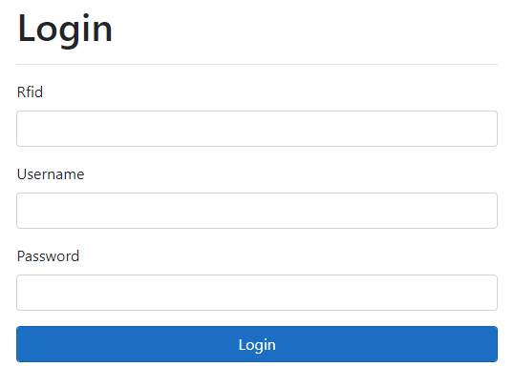
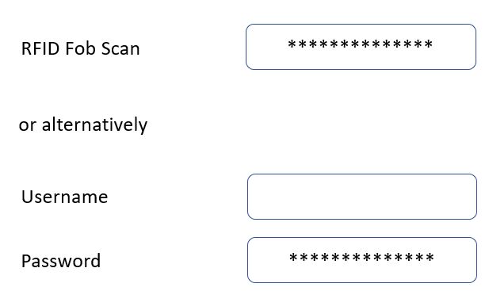
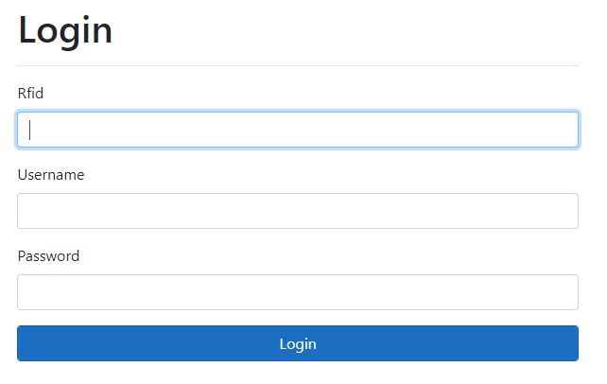
Text missing
RFID fields needs to be in focus on page load

Slide 7
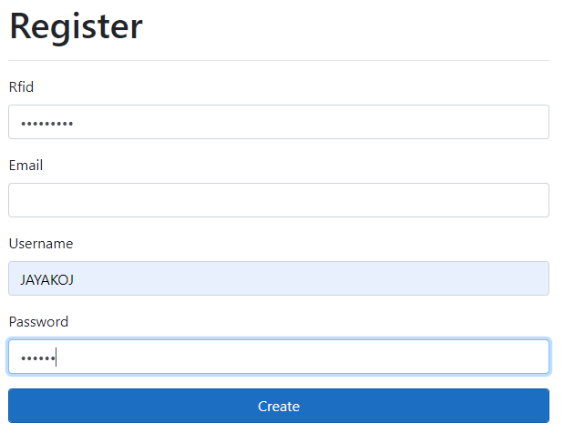
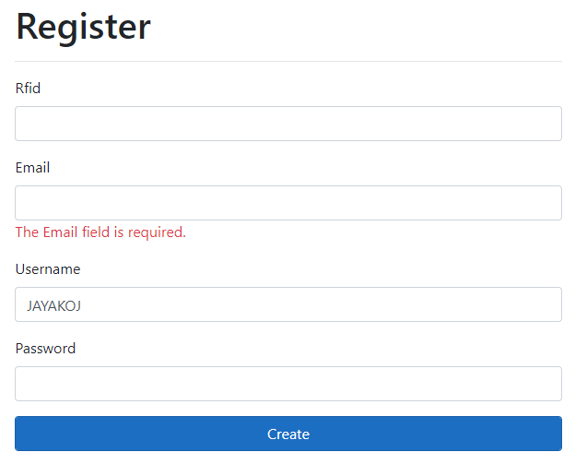
Email field should be optional

Slide 8
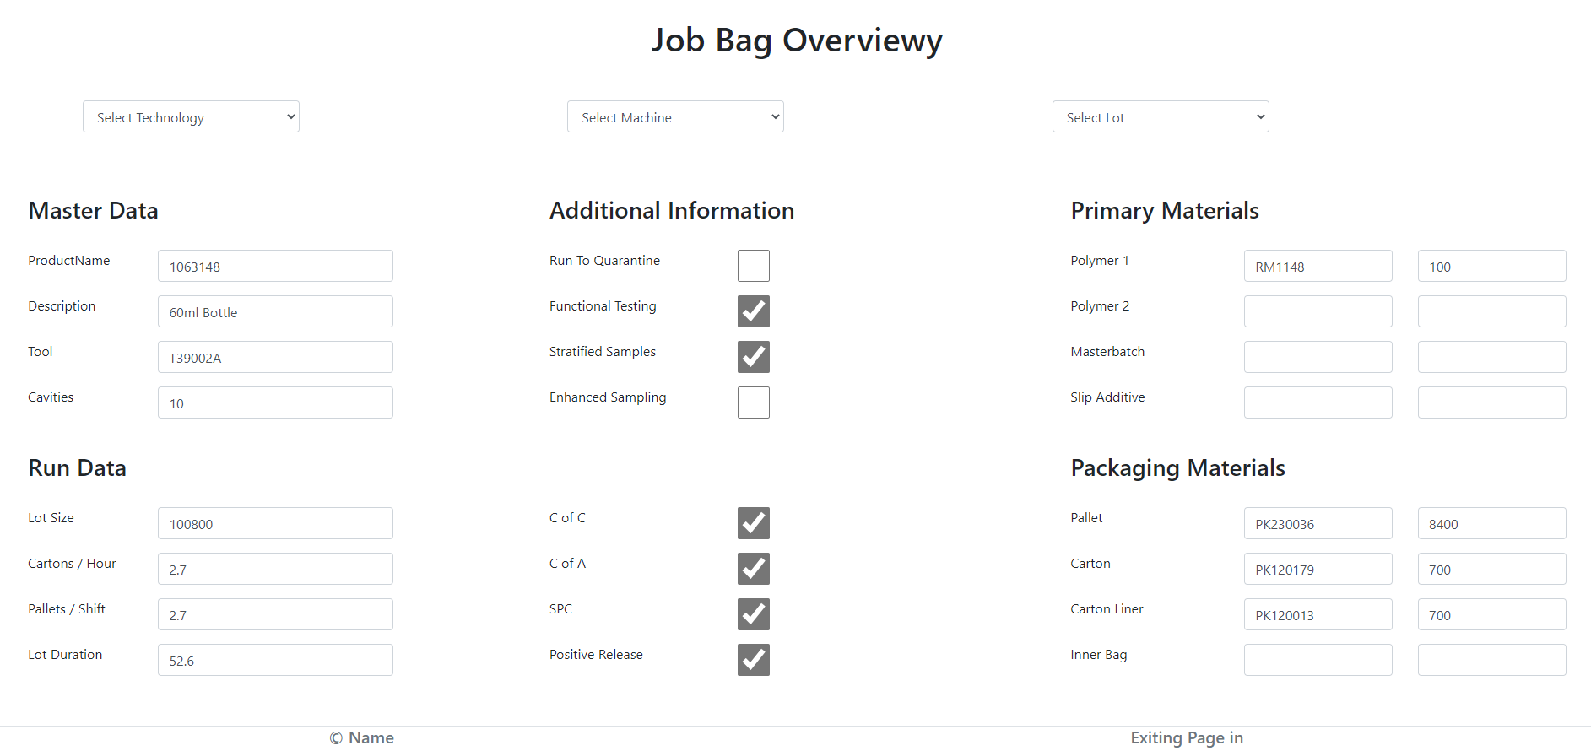
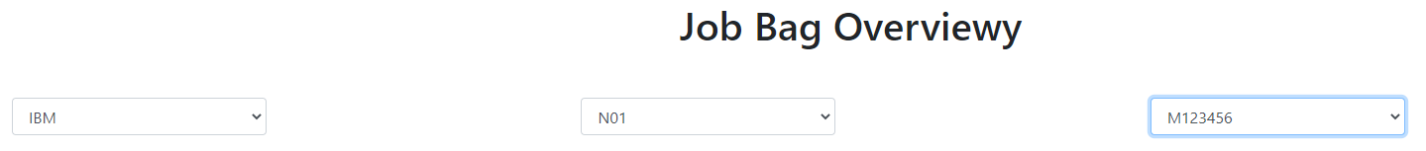
Data not stored when existing and re-entering page
using dropdown menus – should only be cleared at LOGOUT
Fields can be manually edited
No counter
Data not cleared by LOGOUT event
Possible to select technologies, machines and lots that do not match (error message not sufficient)

Slide 9
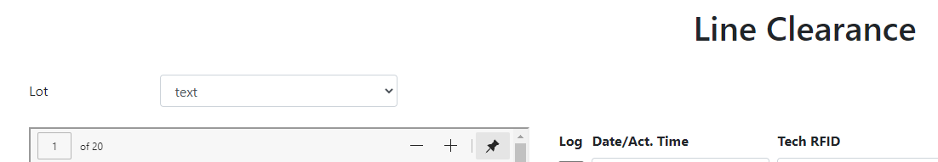
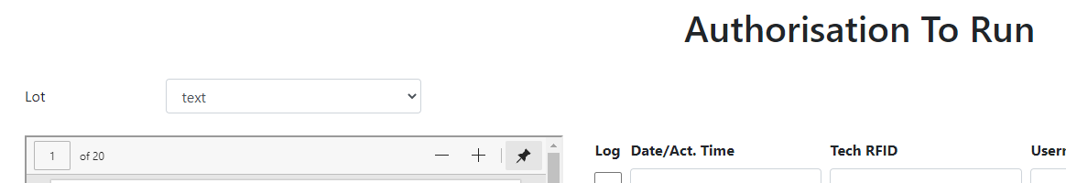
Should be automatically populated
Should be text boxes not dropdown boxes

Slide 10
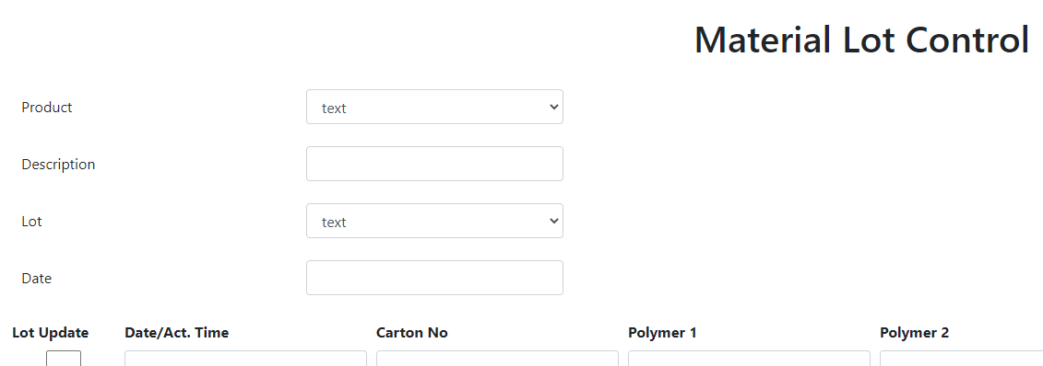
Should be automatically populated
Should be text boxes not dropdown boxes

Slide 11
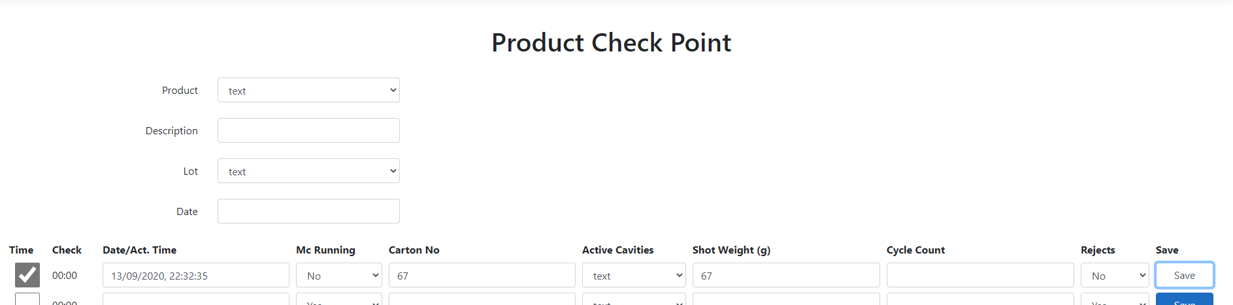

Should be automatically populated
Should be text boxes not dropdown boxes
Default should be blank
Yes selection should open new page 8c
Default should be blank
Yes selection should open new page 8a
Default should be blank
Dropdown should be linked to tbl_Cavitation (numbers 1 to 32)
Yes selection should open new page 8a
Page does not close automatically, counter goes negative and stops

Slide 12
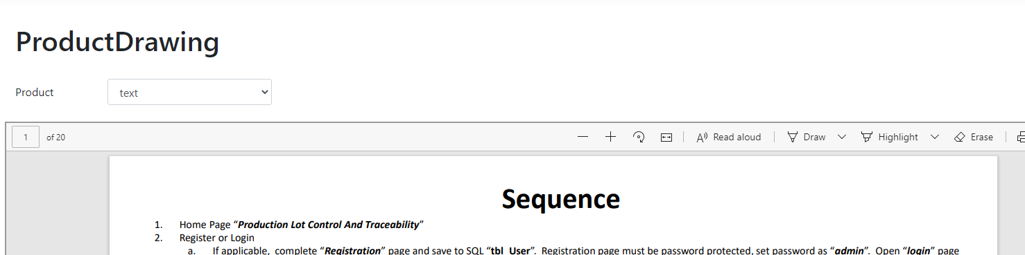
Should be auto-populated
Should be text box not dropdown
Same with PQIS and PS

Slide 13
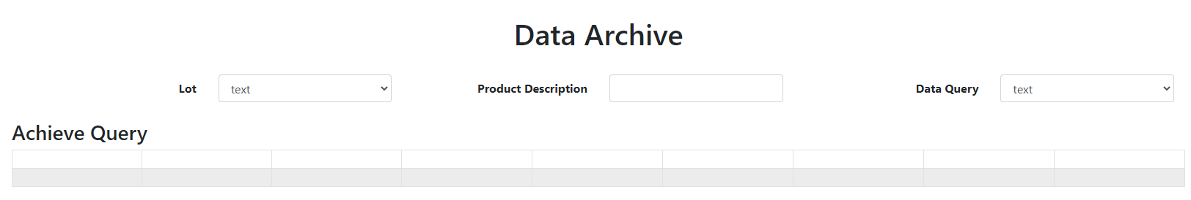
Should be linked to SQL table “tbl_DataArchiveQuery”
Should be linked to SQL table “tbl_Lot”
Should be auto-populated from QSL view selected in
Data Query dropdown box

